Slide 1


Gotham Treats
your friendly neighborhood bakeshop
Adv. ISAD Week 11 Presentation
By:
Nadja Jasmine Donosepoetro - 2602119184
Dycinta Fedianka - 2602185942
Ajhe Ray Delrian - 2602176894
Nicholas Darmawan - 2602158550
Eliott Bastien Mathieu Rivet - 2602214791

Slide 2
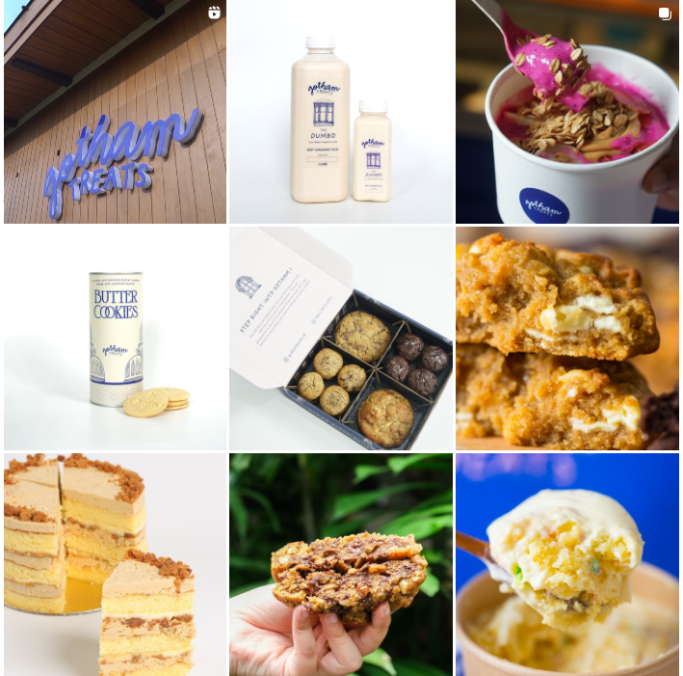
About Gotham Treats
Inspired by their love for New York City, Gotham treats is a small dessert shop nestled in the heart of South Jakarta where they create their own our take on the American classic sweets.
Their sweets are baked fresh and made with the utmost care in small batches. Their products include cookies, puddings, milks and pies.
20+ Employees
Retail Industry: Bakeshop

Slide 3
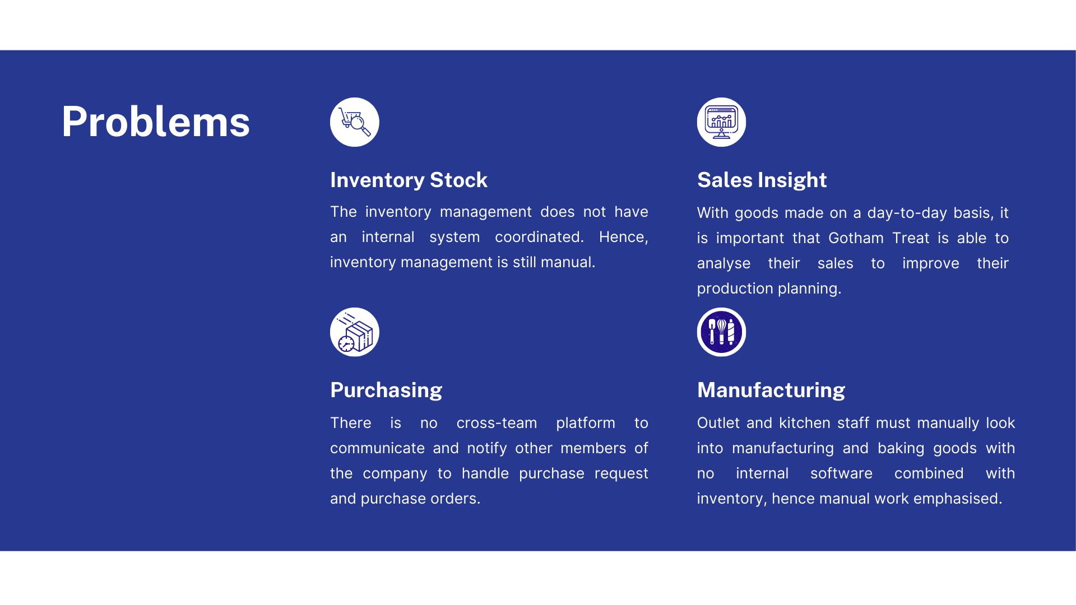

Slide 4
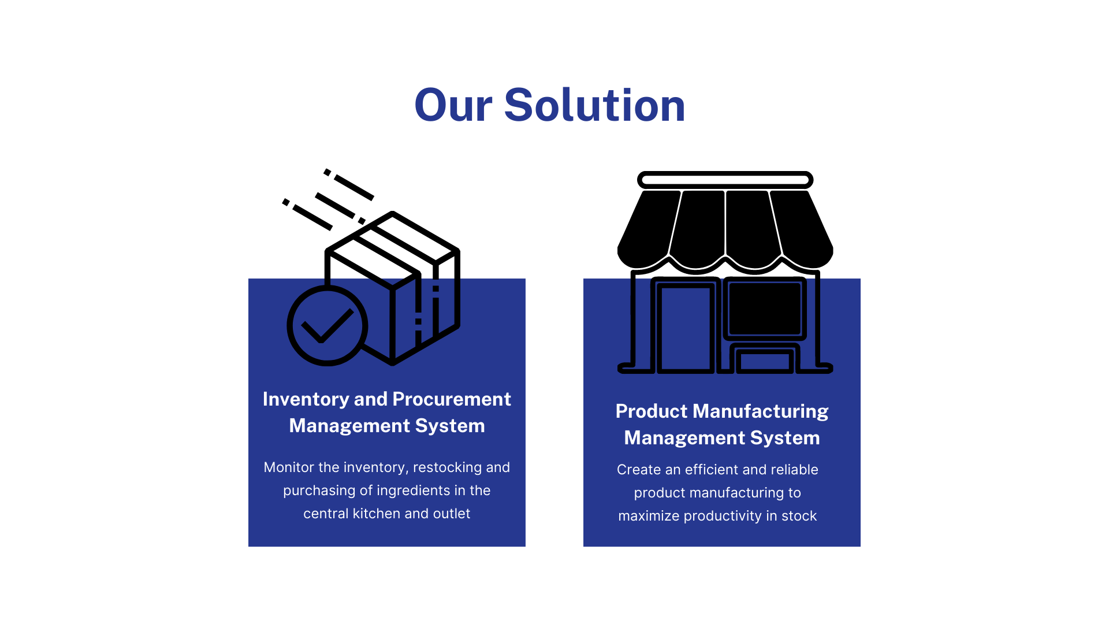

Slide 5
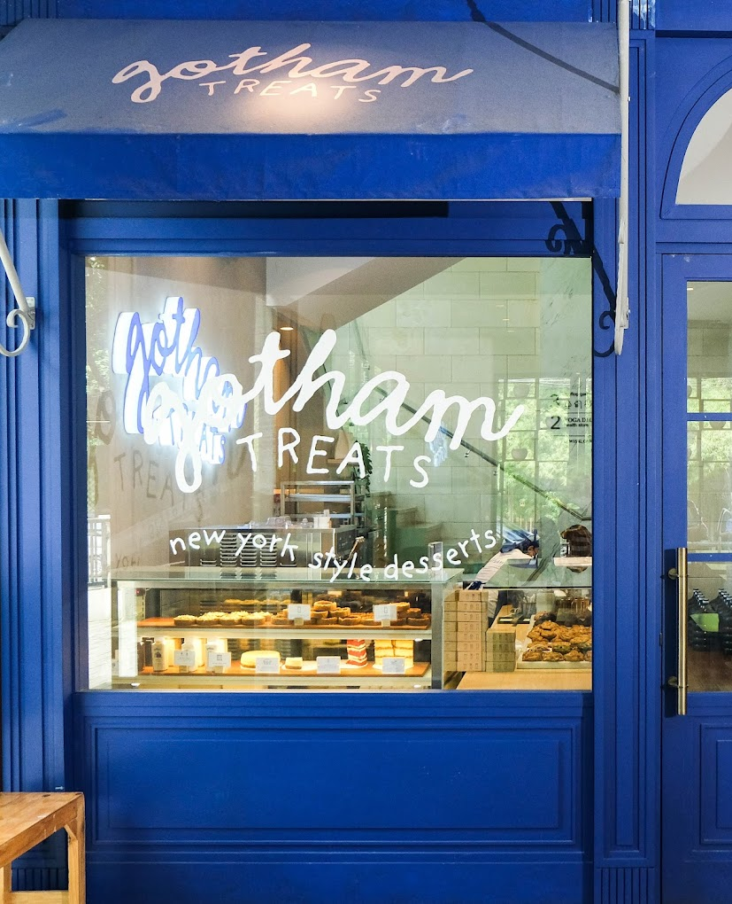
Table of Contents
Value Analysis and Proposition
Deliverable Structure Chart
Drivers and Triggers
Process Selection Matrix
End to End
Use Case Diagram
Multilayer + First Cut
Revised Cut Class Diagram
UI/UX

Slide 6
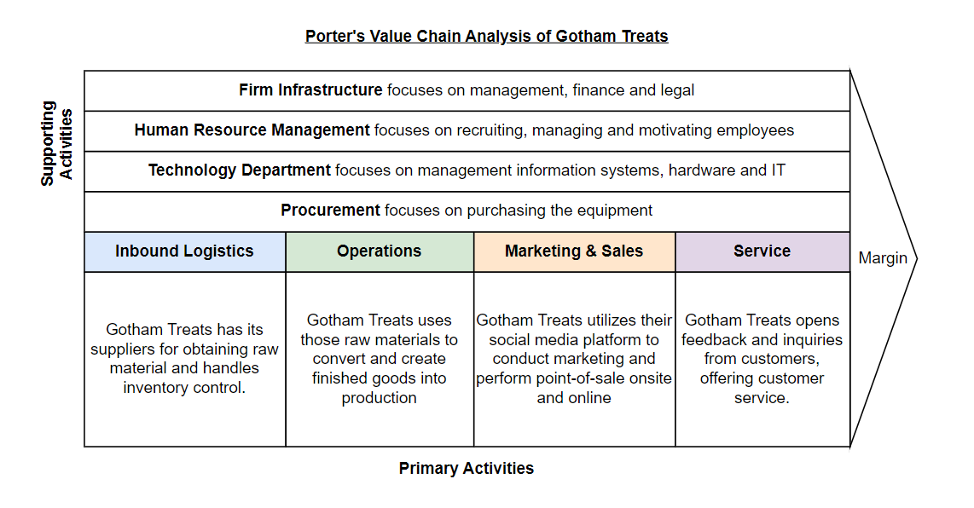
Value Analysis

Slide 7
Value Proposition
 | Operational Excellence | Product Leadership
Core Business Processes | With high customer demand, there is need to match with the supply | Create innovative products (flavors and bakeshop items) and explore the reach and sales in the market
Organization and Structure | There is a central authoritative with power, mainly the co-founders and the managers are in power | The organization structure is organic and loose
Management Systems | There is standard operating procedure to ensure high quality is achieved. | Through product innovation, risk can be expected and it rewards people for innovation and creativity in its products.
Culture: Mindsets and Behaviour | The focus is on making the system effective and efficient | The focus is on innovating and creating a breakthrough in the market.

Slide 8
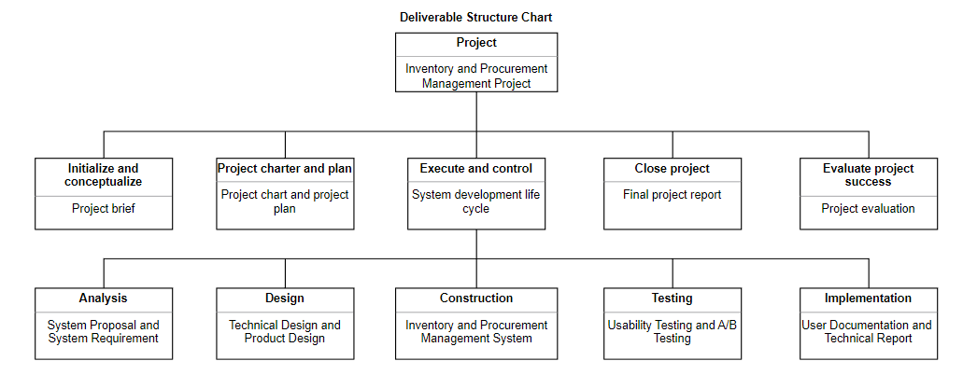
Deliverable Structure Chart

Slide 9
Drivers and Triggers
The drivers and triggers behind BPM initiatives are in the organization and management sector. In the organization sector, it is important that with the growing demand for the products especially the ice-cream, it is essential that Gotham Treats can reach its supply to match the demand from the customers. Hence, the aspect of high growth is one of the drivers behind having an improved business process management system.
As for the management sector, with Gotham Treats building many branches, the system must be able to expand and scale their system to ensure that their process runs smoothly for all branches within the company. In addition, the management sector needs to build efficiency for their performance and hence, must make their processes smooth in order to maximize sales and business resources. Thus the driver and trigger within the management sector for Gotham Treat’s BPM is improving performance and business expansion.

Slide 10
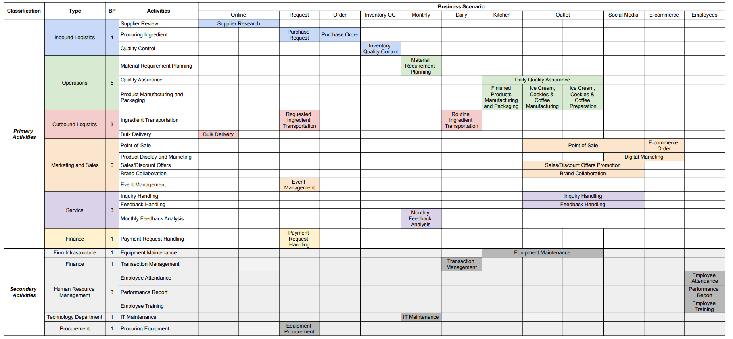
Process Selection Matrix

Slide 11
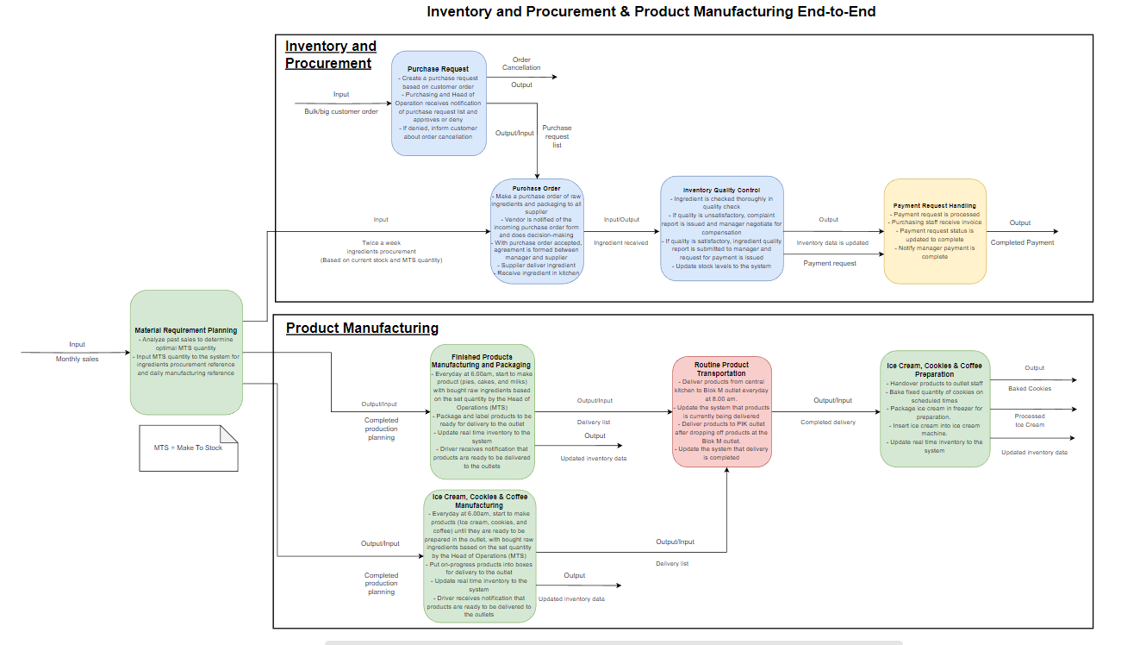
End to End

Slide 12
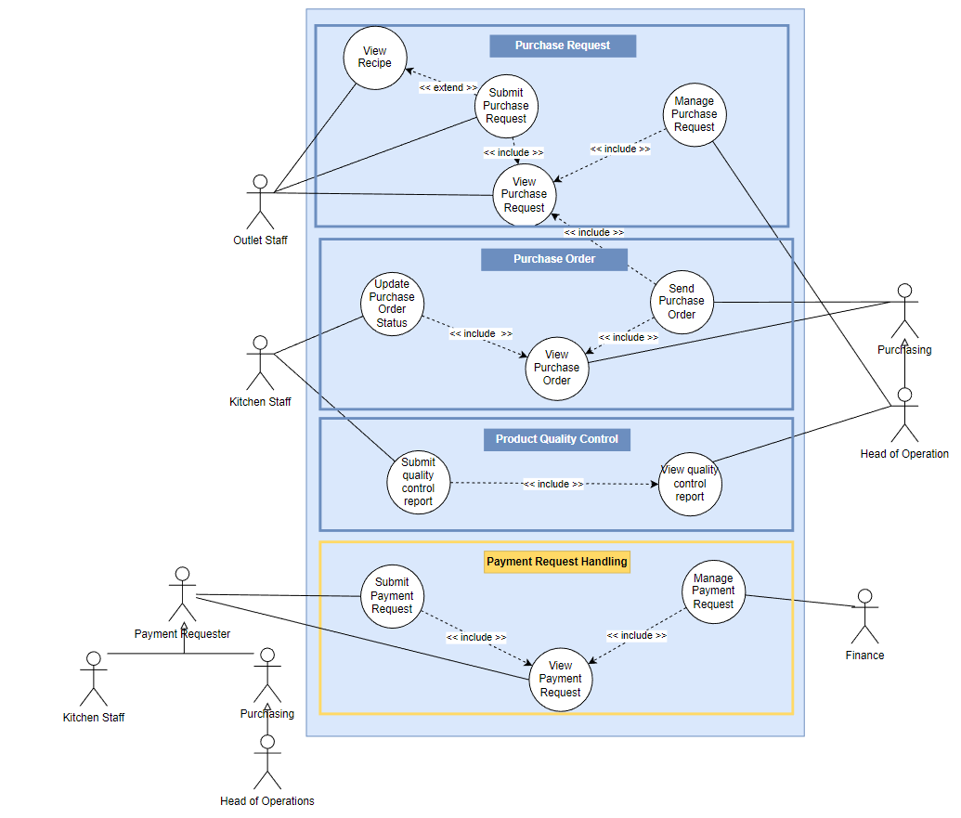
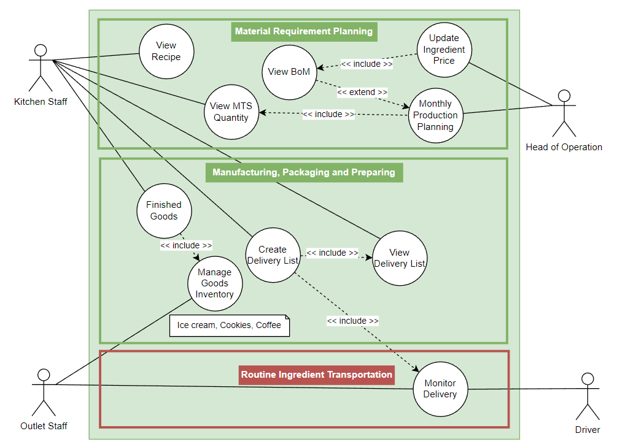
Use Case Diagram

Slide 13
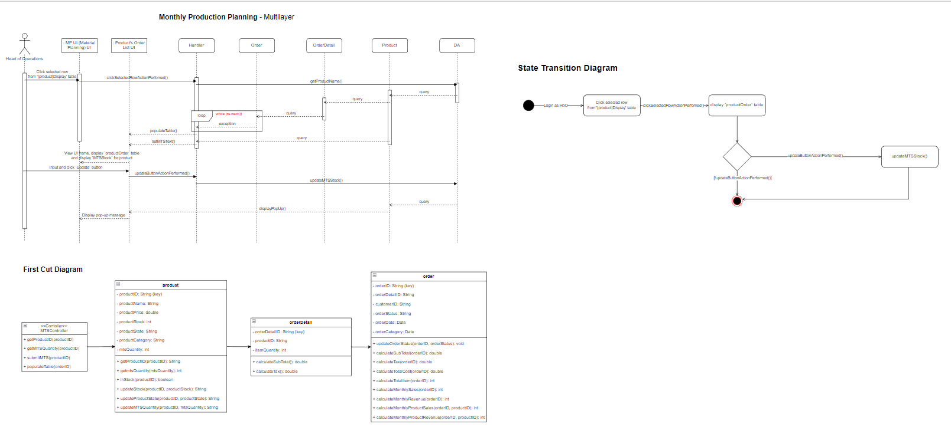
Use Case: Monthly Production Planning

Slide 14
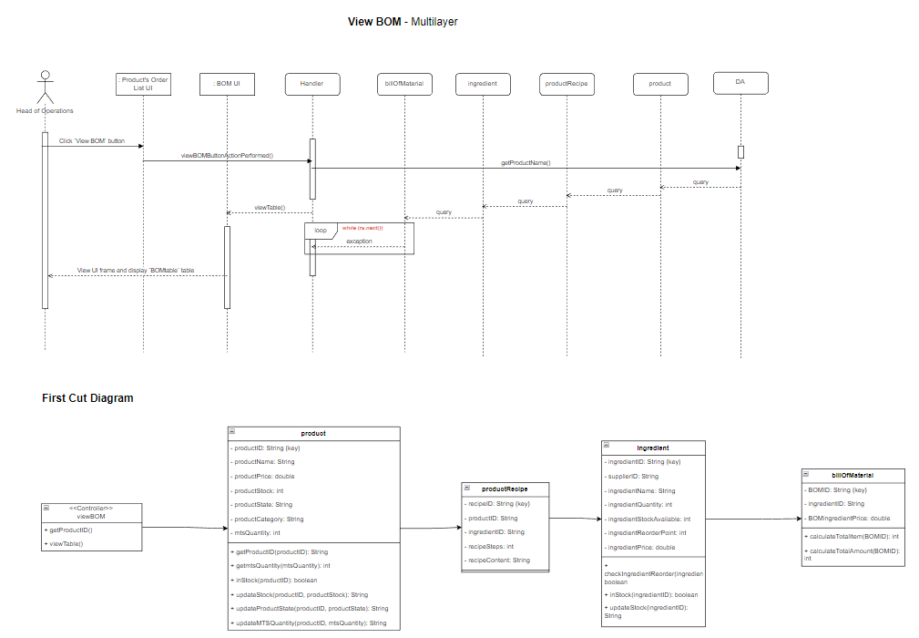
Use Case: View BOM

Slide 15
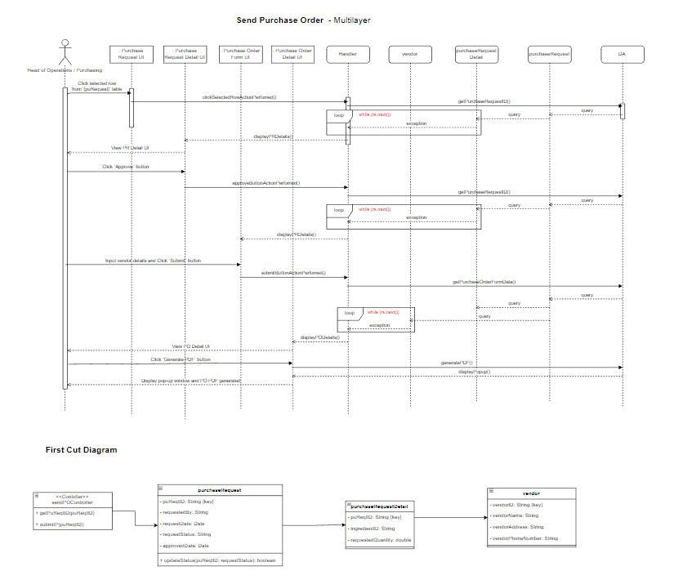
Use Case: Send Purchase Order

Slide 16
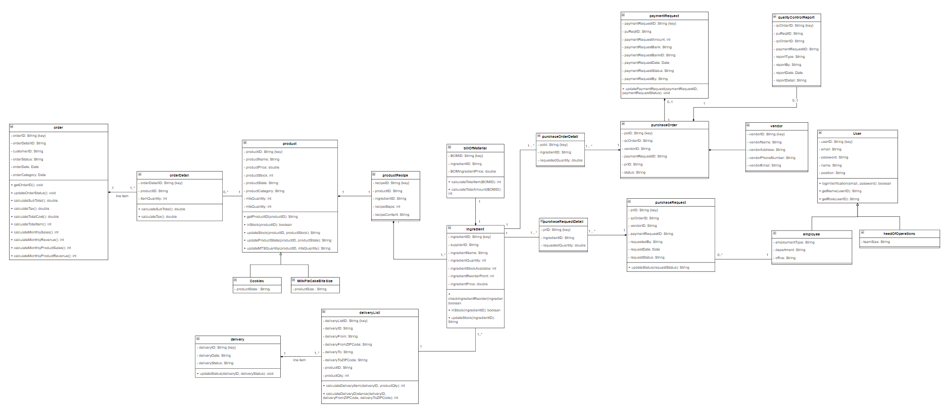
Revised Cut Class Diagram

Slide 17

Head of Operations
Responsibilities:
Decide on the make to stock quantity per day for each product every month for material requirement planning
Evaluate each incoming purchase request and send purchase order to vendor through form.
View quality control report once purchase order has arrived.
Submit payment request once purchase order is satisfied.
Related Use Case:
Manage Purchase Request
Send Purchase Order
View Purchase Order
View Quality Control Report
Submit Payment Request
View Payment Request
Monthly Production Planning
Update BOM
View BOM
View MTS Quantity
Notes:
NICHO JELASIN

Slide 18
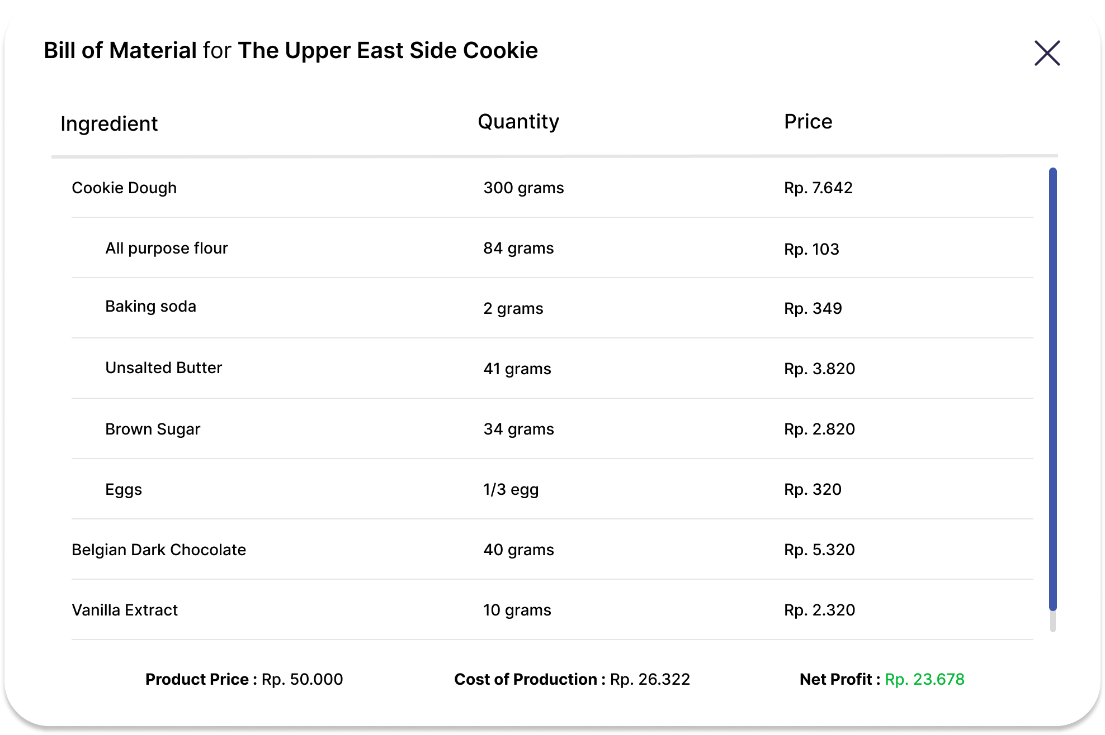
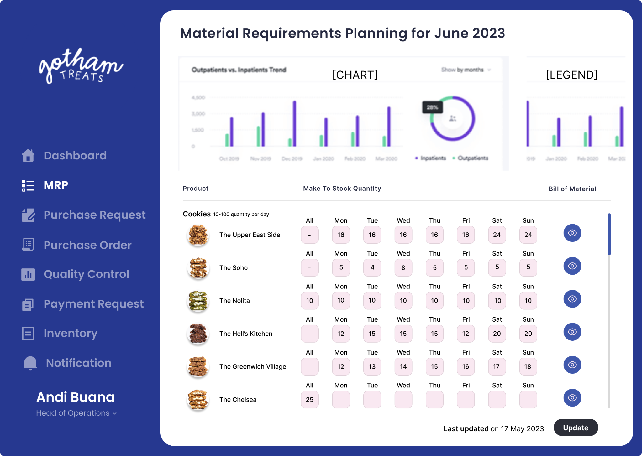
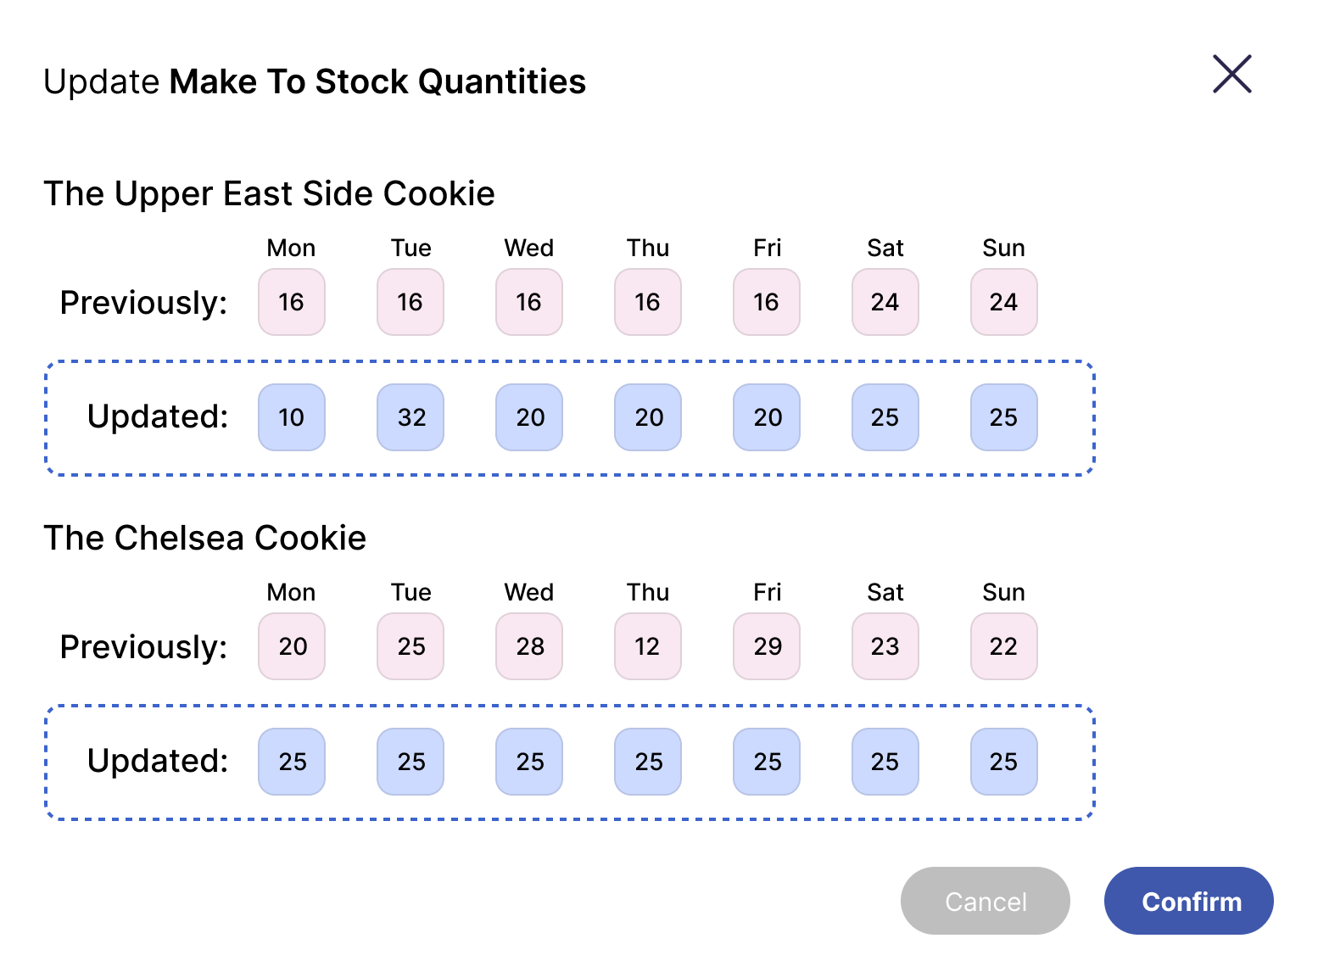
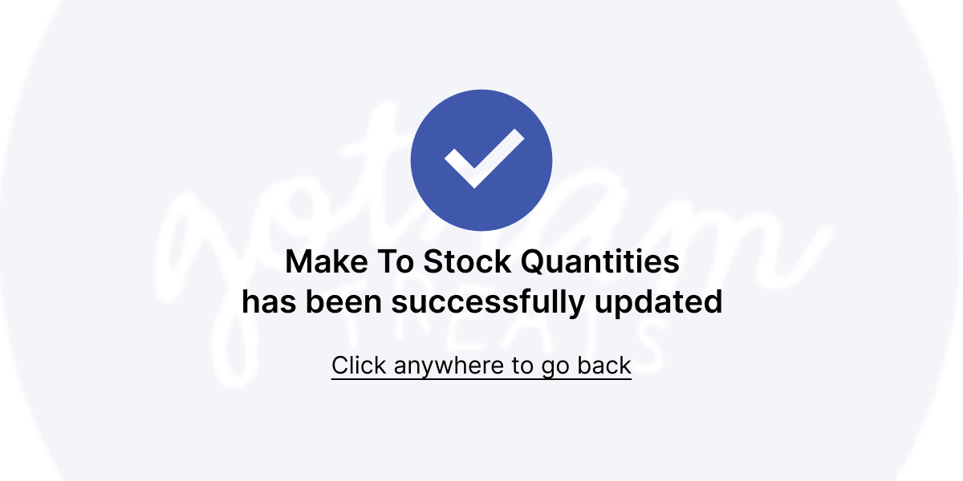
Head of Operations
Material Requirements Planning UI

Slide 19

Purchasing Staff
Responsibilities:
Handles evaluating purchase Evaluate each incoming purchase request and send purchase order to vendor through form
Submit payment request once purchase order is satisfied
Related Use Cases:
Send Purchase Order
View Purchase Order
Submit Payment Request
View Payment Request

Slide 20
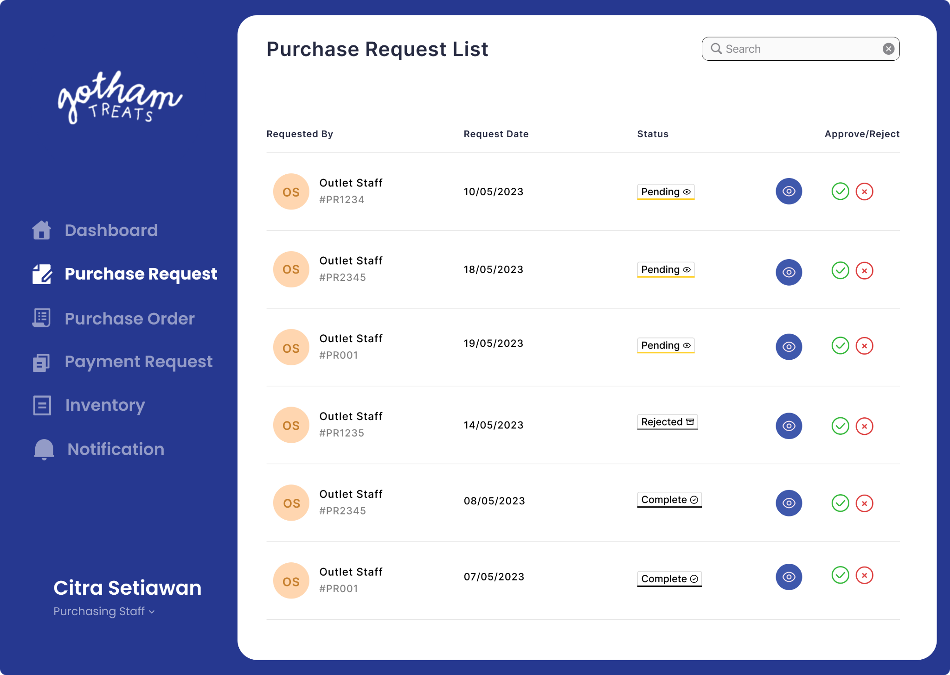
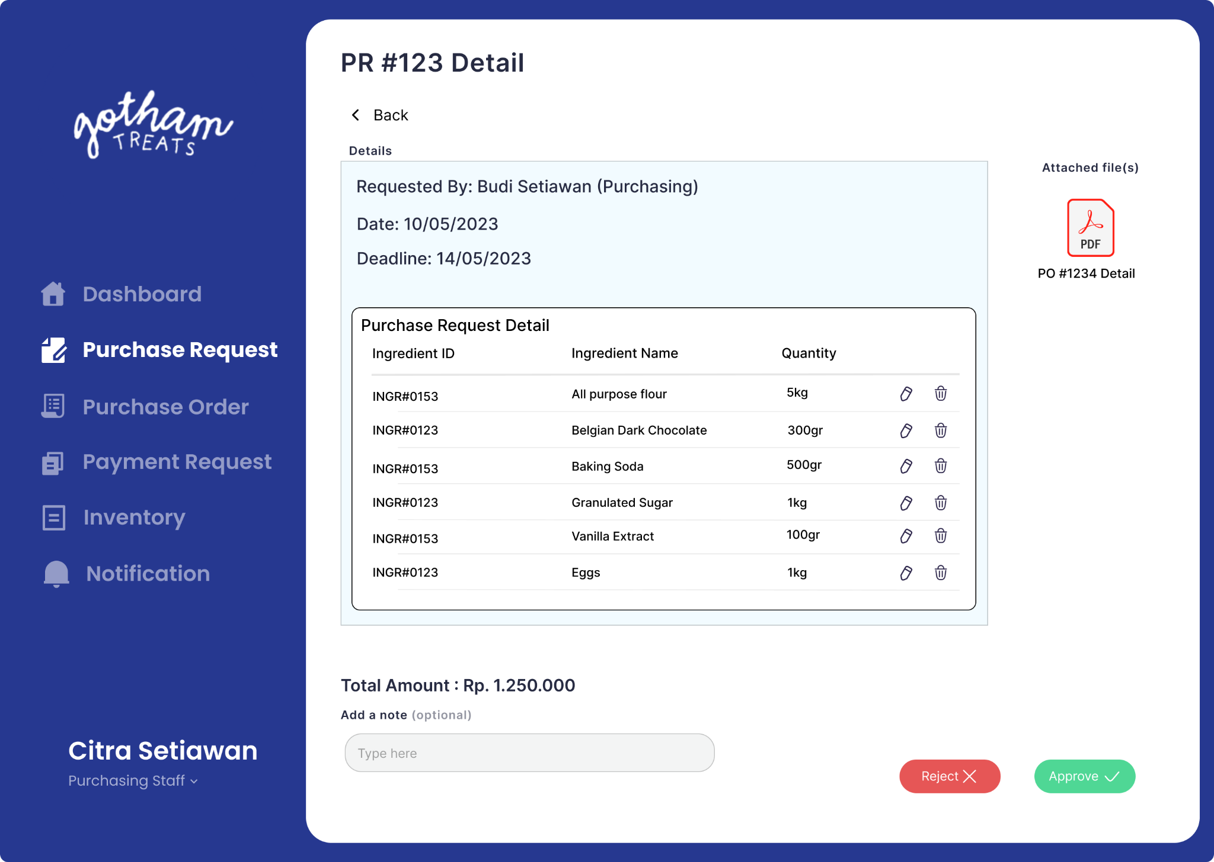
Purchasing Staff
Purchase Request List UI
Purchase Request Detail UI

Slide 21

Kitchen Staff
Responsibilities:
Update status and arrival of the items according to the purchase order
Submit quality control report after purchase order item has been arrived into the central kitchen
Create and monitor delivery list to track delivery items (inventory goods) and location from kitchen to outlet
Manage goods inventory
Related Use Cases:
Update Purchase Order
View Purchase Order
Submit Quality Control Report
View Recipe
Submit Payment Request
View Payment Request
View MTS Quantity
Finished Goods
Manage Goods
Inventory

Slide 22
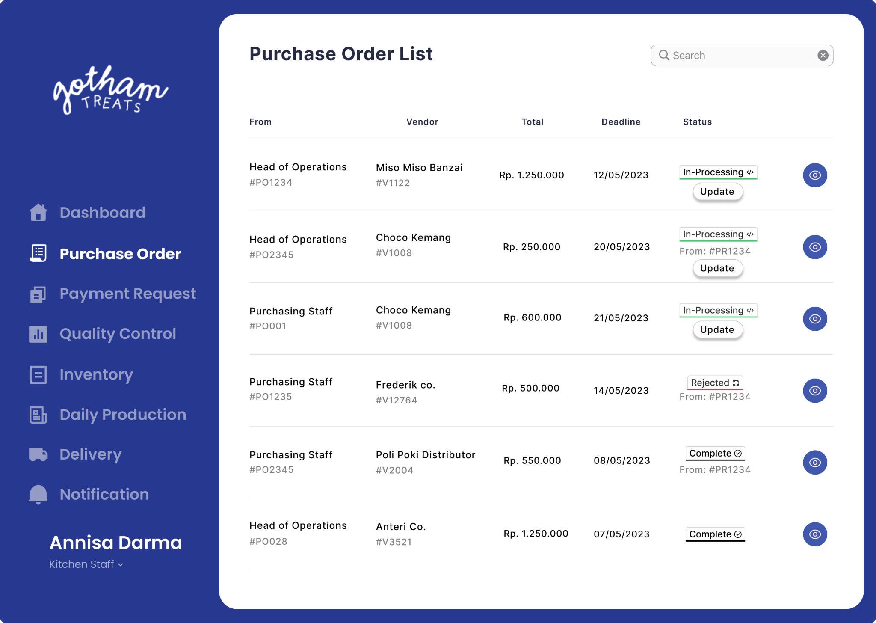
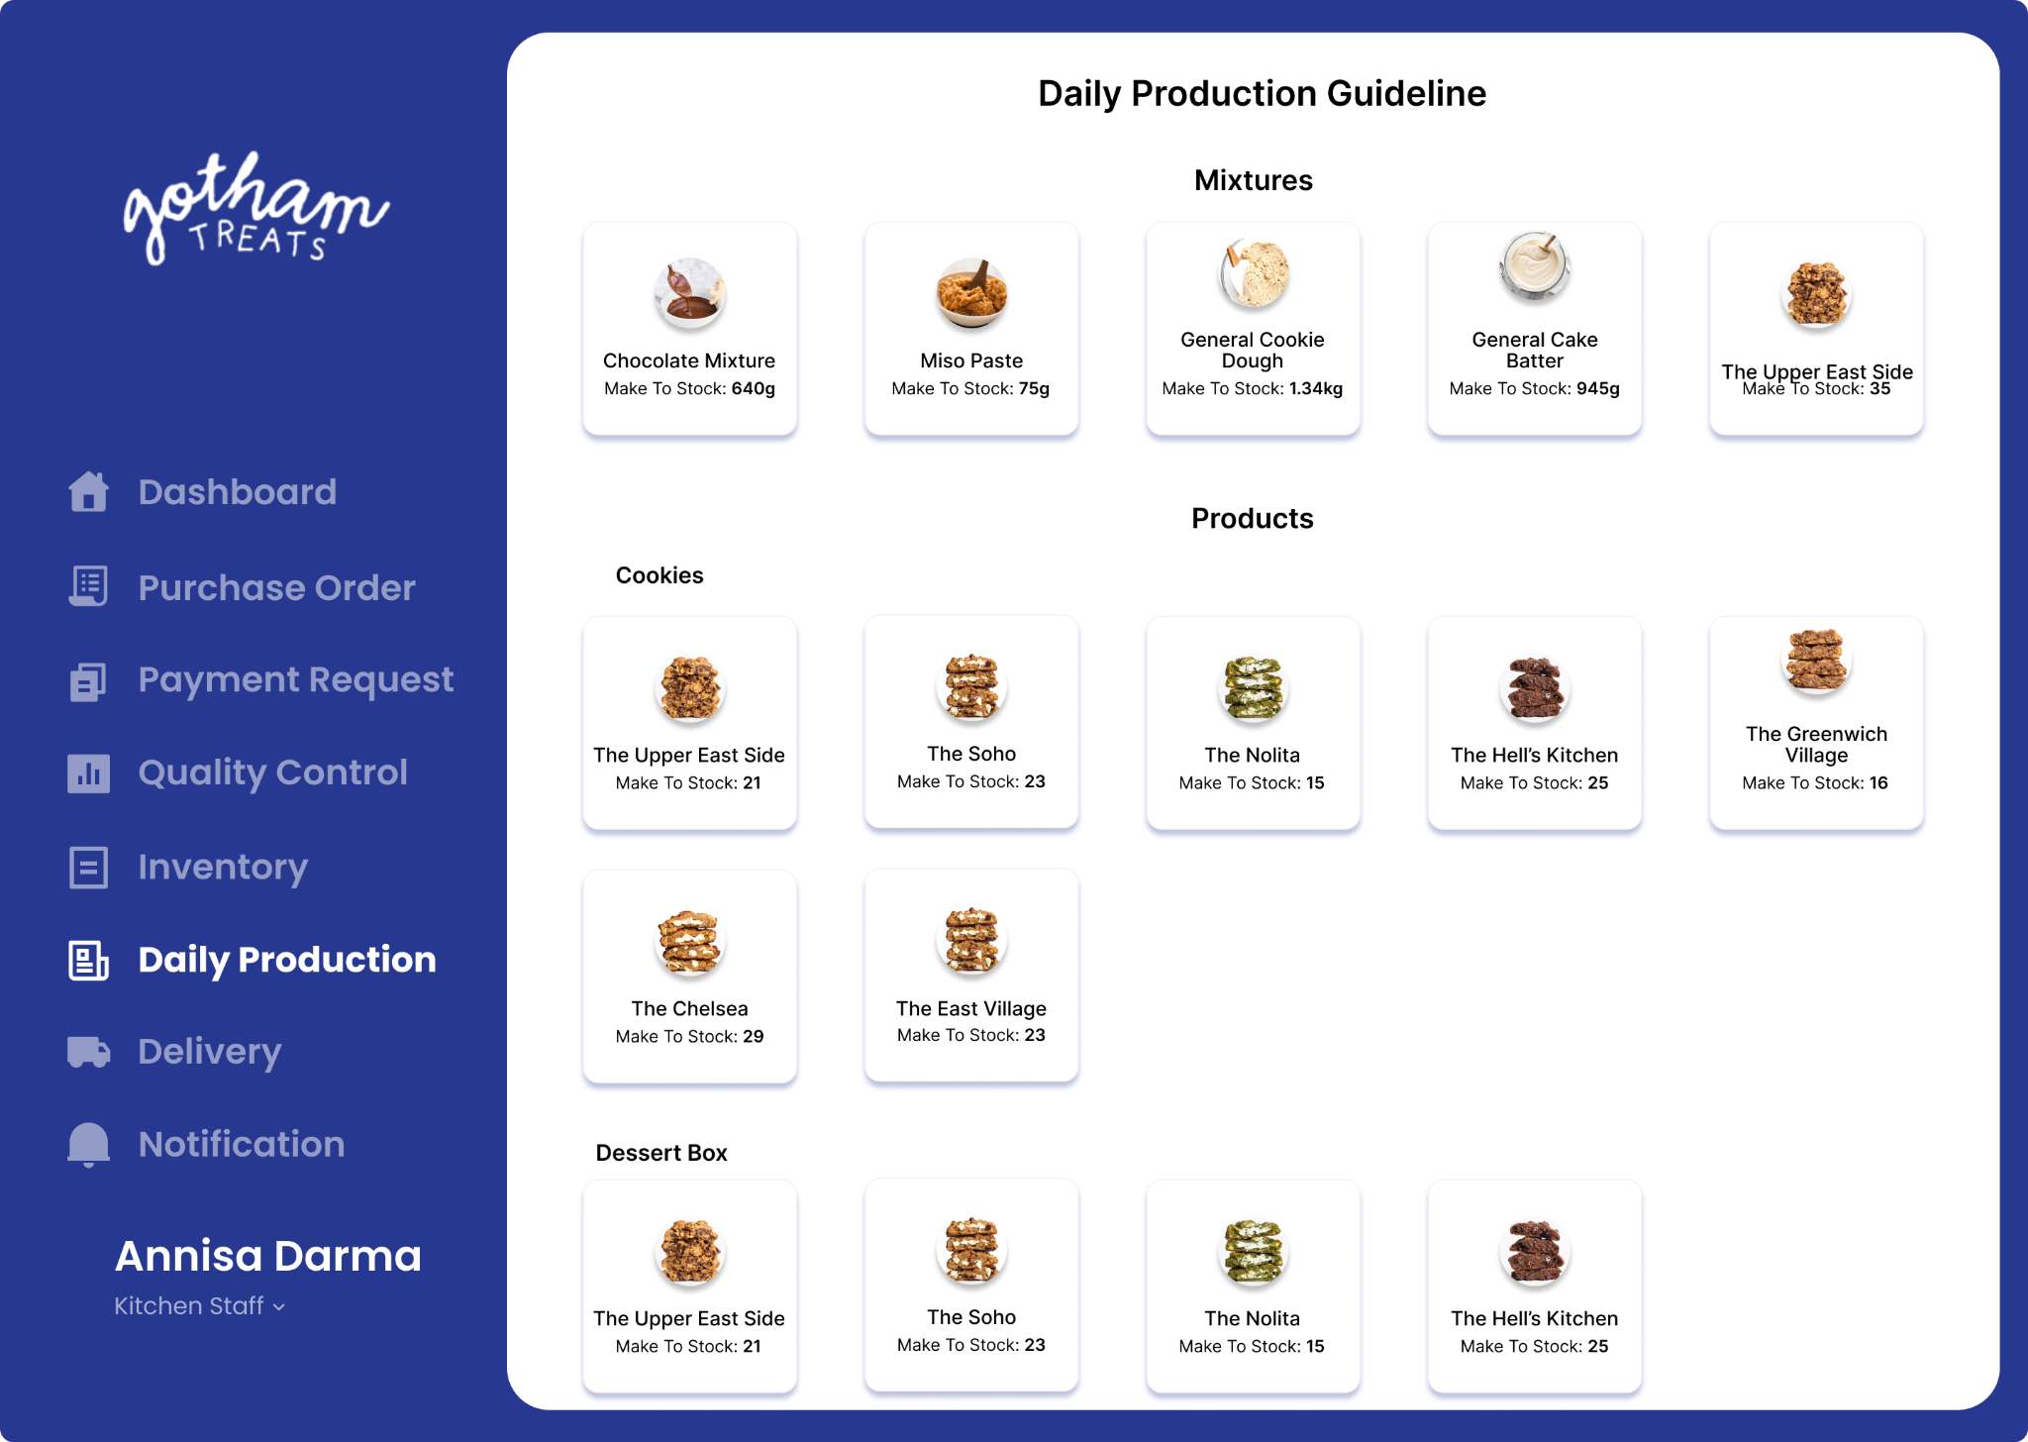
Kitchen Staff
Purchase Order List UI
Daily Production Guideline UI

Slide 23

Outlet Staff
Responsibilities:
When an incoming bulk order is made, they need to submit a purchase request
Once purchase order is approved, they are able to submit payment request and view its details including status
Outlet staff are able to view production planning and manage their current inventory
With an incoming delivery of ingredients, they are able to monitor and keep up-to-date with delivery
Related Use Cases:
Submit Purchase Request
View Purchase Request
View Production Planning
Manage Goods Inventory
Monitor Delivery

Slide 24

Finance Staff
Responsibilities:
Evaluate the incoming payment request and do the necessary transactions
Handle and execute the transaction and invoice
Update the payment request status accordingly
Related Use Cases:
Manage Payment Request
View Payment Request

Slide 25
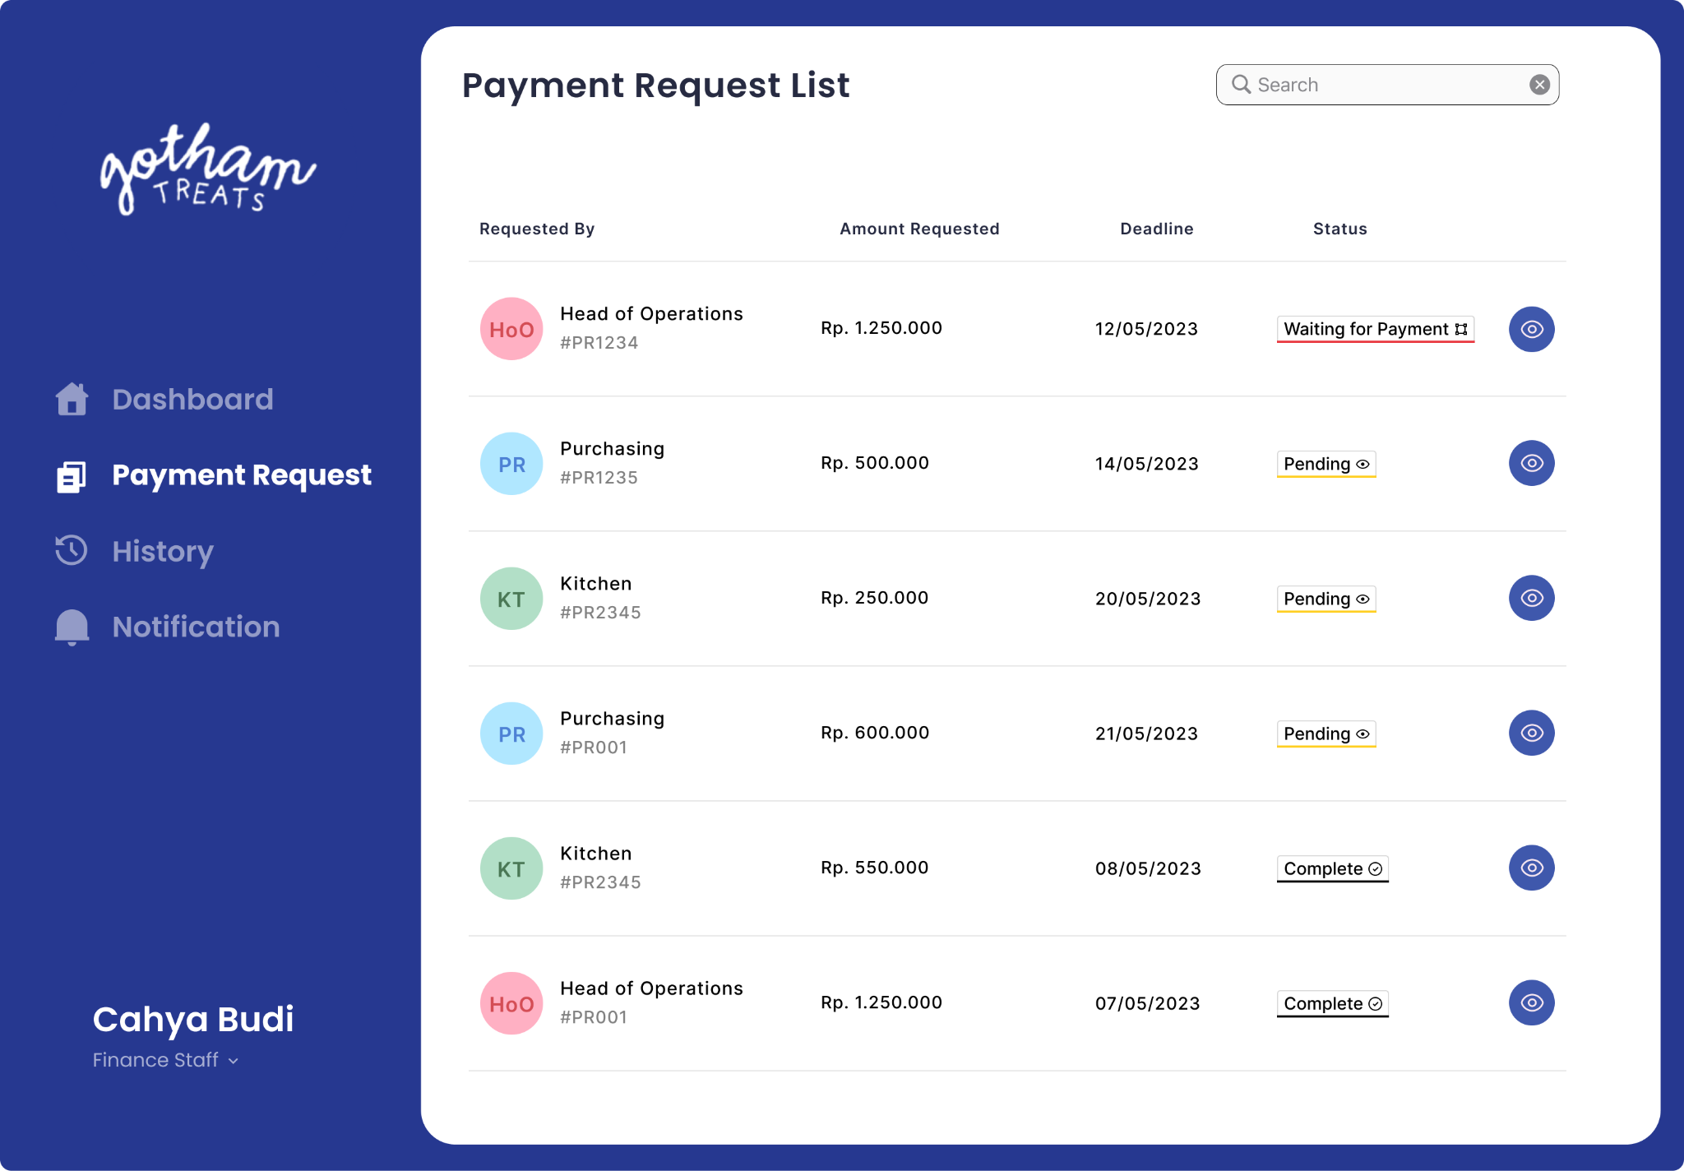
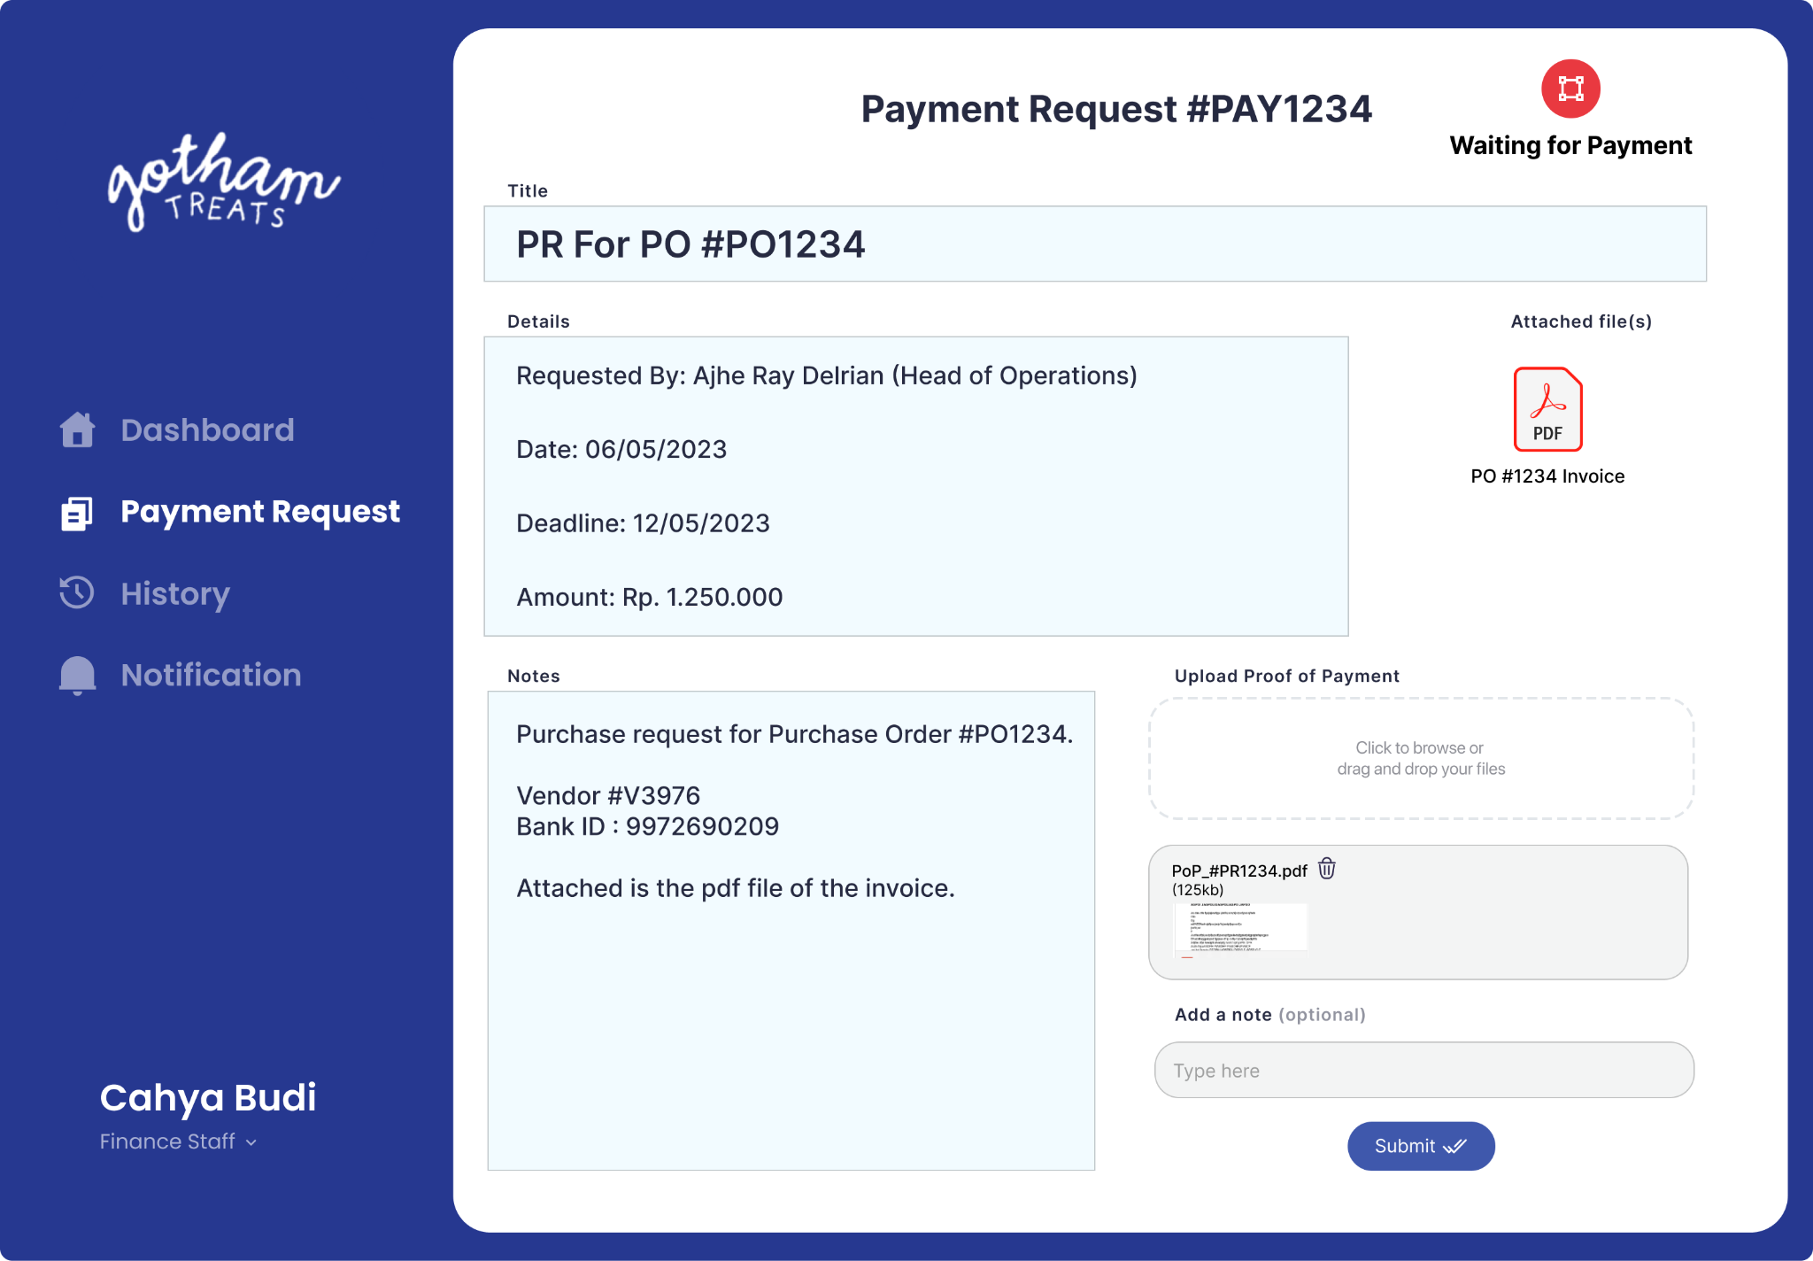
Finance Staff
Payment Request List UI
Payment Request Detail UI

Slide 26
Thank you

